Slide 1

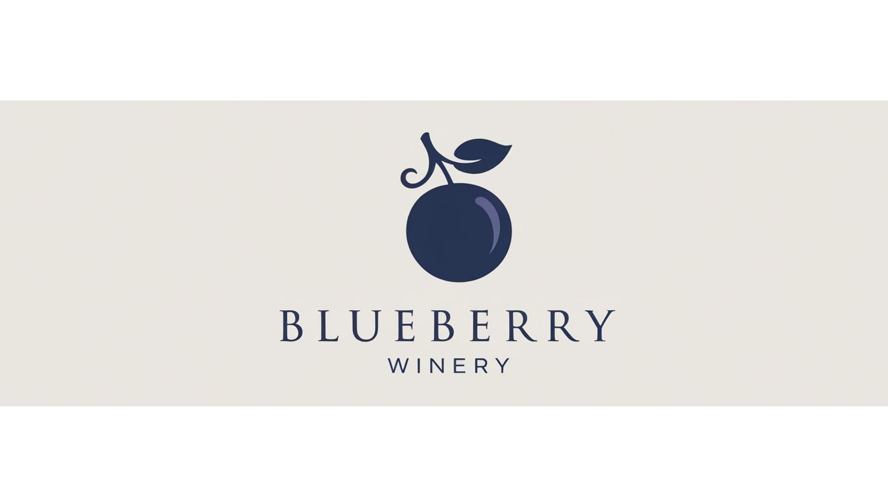
Wine Quality Analytics System
Presentation of the
Determining the quality of white vinho verde wines based on their physicochemical composition
A cooperation of

Slide 2
Agenda
The Wine Quality System
The Challenges
Data Insights: Alcohol and Density
The Machine Learning Model
Results
Conclusions

Slide 3


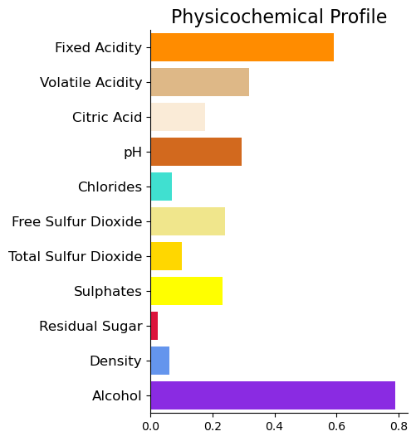
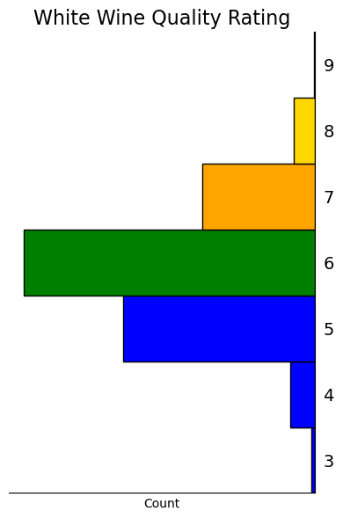
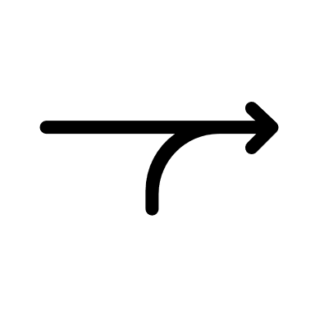
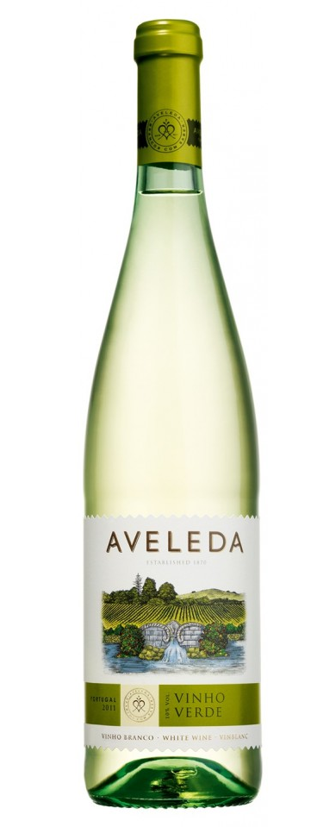




The Wine Quality System
Marketing
Tasters
WQAS
Wine Quality Analytics System supports the tasters with finding high quality wines
The system can be continuosly improved.
Notes:
Short introduction into the data set in order to align everybody and present some domain knowledge.
Physicochemical composition is linke to quality rating by wine tasters
Introduce Quality Label? Yes
Display Idea:
Bar Charts that represent the physicochemical composition
Quality histogram 1-10, whereas colors indicat the quality label!

Slide 4
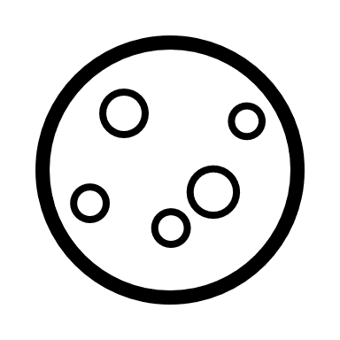

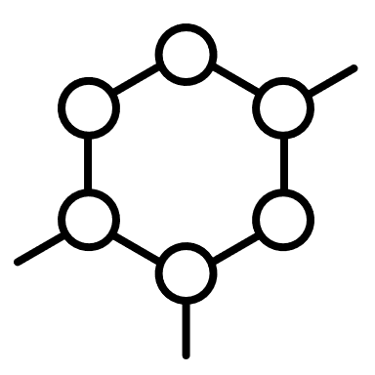


Challenges
complex mixture of >1000 substances resulting from a complicated process
The taste is the least understood human sense and highly individual
Each chemical composition has it‘s own appeal
Low data coverage
11 components
3500 samples
1 quality rating
Only a few high quality wines
Noisy, high-dimensional, non-linear, interdependent relation between Quality and Features
Weak representation
Notes:
How is wine quality related to the physicochemical properties?
Alcohol, density, residual sugar
Density gets lower with more alcohol, but higher with increasing residual sugar
More alcohol reduces sugar, but how much sugar remains in the wine is dependent on the grapes used.
Density also contains valuable information:
Tannins and phenols determine the wine aroma which increase the density (?). They were not measured and probably are difficult to measure.
It determines the mouthfeel of the wine.
Residual sugar determines the sweetness of the wine.
Alcohol is a main characteristic for it‘s quality, however this might not be because all tasters are alcoholics rather, because
Alcohol carries the taste
A higher alcohol content indicates a full fermentation process, which if done well, may release all possible flavors.
Show that the main contributor to quality, alcohol, does not show a clear relation to quality
Box plot or dot plot with STD: Low quality wines may also have a high alcohol content
Residual Sugar, Alcohol, Density – Mapping: Look for groups of data!
Weak (linear) relation of the features to quality:
Correlation matrix
Noise
Reasons for unclear relations:
The Quality rating of the tasters is only weakly linked to an individual feature; wine is a complex mixture of many components and their concentrations
The given set only weakly represents the quality features of wines
Show the very complex interrelations of the features when it comes to taste
Non-linear, e.g. volatile acidity in general: too little is bad, too much is bad, acidity in general
Interdependent, i.e. they may balance each other, e.g. citric acid and residual sugar.
Apart from that:
Taste rating is highly individual, although it‘s a mean of at least 3 wine tasters.
We need the variance! It might be the case that 1, 10, 5 was rated.
Factors for quality ratings of wine tasters are multi-faceted: taste, mouthfeel, smell, color etc. these are only weakly represented
This introduces more noise.
Taste is the least understood human sense.
No std
Verification / outlier handling is difficult: we cannot validate features against each other
E.g. high density wine: this might be an error, it cannot be
Conditioning of the problem
All in all, it‘s good that you have contacted me for this complex problem!

Slide 5
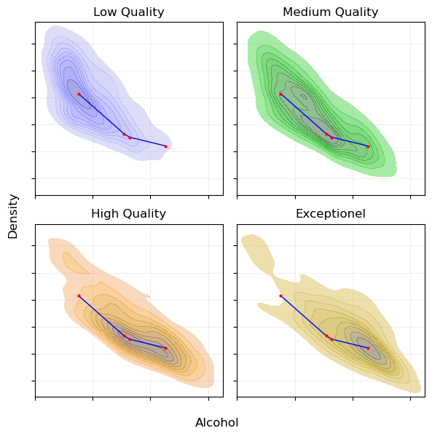
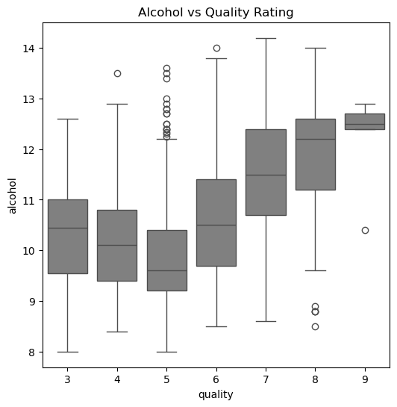
Examples: Alcohol, the main Quality Indicator

Slide 6
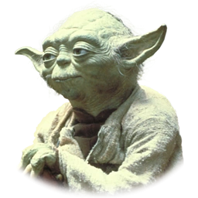
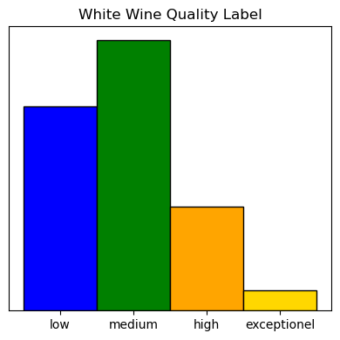
Machine Learning Model
Random Forest Classifier with high recall we need, hmmm!
Data preprocessing
Remove Duplicates
Outlier handling
Use Univariate and multivariate methods
Drop low quality outliers
Scaling
Feature Engineering
Introduce Quality Label
Incorporate Features Interactions
15 most important interactions
Avoid interactions of noisy features
Hyperparameter
Tuning
Optimize for high recall
Model Training and Evaluation
Fix class Imbalance: Over- and Undersampling
Pay attention Overfitting
Notes:
How was the machine learning model built?
Random Forest Classifier
Preprocessing Steps
Outliers (Refined method to find outliers which will stay top secret today)
Scaling of the features
Interaction Terms
Noisy data was avoidedd
which were eliminated
Sampling for Training of the model
What were the main considerations?
Getting a model with high recall and precision, meaning a f1_score
Tuning of the model to get this: Hyperparameter Tuning
How was the complexity of the problem accounted for?
Quality Label was chosen such that class imbalance is as low as possible + very high quality
Interaction Terms: investigate the iteractions and reduce the influence of noisy quantities
Account for class imbalance

Slide 7
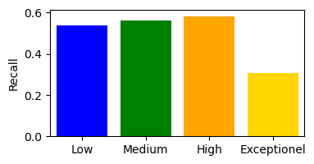
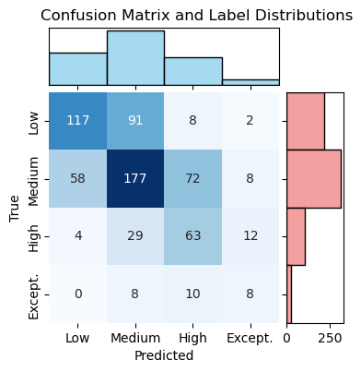
Results
Pros
Model predicts both high quality categories pretty well
Reasonable parameters and param. behaviour
Feature Importances
Cons
Accuracy 0.54
Low
Big gap to training accuracy
Notes:
Evaluation
Fitting Quality / Overfitting
OBB score: close to Training score
Cross Validation: std ok
chance of overfittig is lower
Performance Scores
Accuracy pretty low, as expected
Recall high: How many relevant items are retrieved?
Matrix looking good

Slide 8
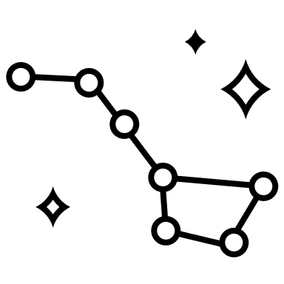
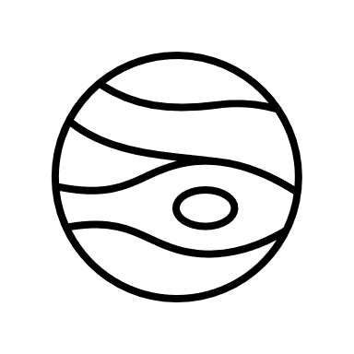
Conclusions
WQS in practice
The model can support the Tasters in selecting a good wine with zero effort.
It has to be used with caution, wine quality still has to be finally determined by an expert.
Ensure a good fermentation process.
More Data!
Ensure high data quality
Continue collecting data
Measure more quantities
Standardize quality measurements
Model Refinement
Mulitlabel classification
Advanced algorithms can be applied

Slide 9
Thank you for your attention! Are there any Questions?
Notes:
Show the final result again on this page

